Slide 1


A+ Guide to Managing and Maintaining your PC, 6e
Chapter 5
Processors and Chipsets

Slide 2
Objectives
Learn about the many different processors used for personal computers and notebook computers
Learn about chipsets and how they work
Learn how to keep a processor cool using heat sinks and coolers
Learn how to install and upgrade a processor

Slide 3
Introduction
The processor and chipset
  Most important components on the motherboard
  Main topics of Chapter 5
The processor is a field replaceable unit
The chipset is embedded in the motherboard
Key skills to learn:
  Making wise purchase decisions
  Installing and upgrading a processor

Slide 4
Processors
Processor and chipset are located on motherboard
  Components determine power and features of system
Major manufacturers: Intel, AMD, and Cyrix
Factors used to rate processors:
  System bus speeds supported; e.g., 1066 MHz
  Processor core frequency in gigahertz; e.g., 3.2 GHz
  Word size (32 or 64 bits) and data path (64 or 128 bits)
  Multiprocessing ability and processor specific memory
  Efficiency and functionality of programming code
  Type of RAM, motherboard, and chipset supported

Slide 5
How a Processor Works
Three basic components:
  Input/output (I/O) unit
  Control unit
  One or more arithmetic logic units (ALUs)
Registers: high-speed memory used by ALU
Internal cache: holds data to be processed by ALU
Two types of buses:
  External (front-side) bus: data portion is 64 bits wide
  Internal (back-side) bus: data portion is 32 bits wide

Slide 6
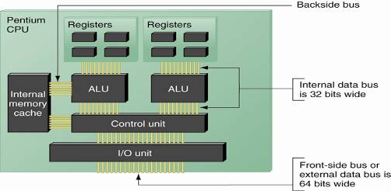
Figure 5-2 Since the Pentium processor was first released in 1993, the standard has been for a processor to have two arithmetic logic units so that it can process two instructions at once

Slide 7
How a Processor Works (continued)
System bus frequency or speed
  Faster than other buses; e.g., 1066 MHz, 800 MHz
Processor frequency or speed
  Refers to speed of internal operations; e.g., 3.2 GHz
  System bus frequency x multiplier = processor frequency
  Overclocking: running processor at excessive speed
  Throttling: decreasing speed when overheating occurs
Data path size and word size
  Data path: transports data into processor
  Word path: number of bits processed in one operation

Slide 8
How a Processor Works (continued)
Multiprocessing
  Simultaneous processing by two or more ALUs
Multiprocessor platform
  Contains two or more processors
Dual-core processing
  Processors share system bus, but have separate cache
Memory cache
  Static RAM (SRAM): holds data as long as power is on
  Lets processor bypass slower dynamic RAM (DRAM)
  L1 cache is on the processor chip, L2 cache is external

Slide 9
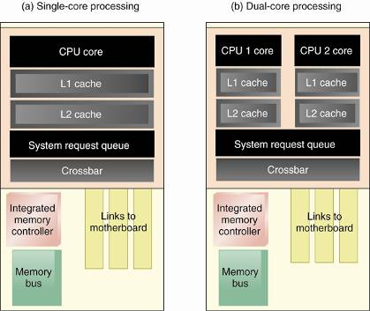
Figure 5-3 AMD dual-core processing using two Opteron processors in the single processor housing

Slide 10
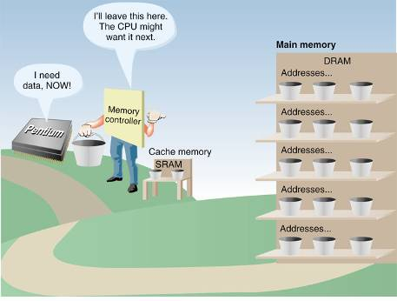
Figure 5-4 Cache memory (SRAM) is used to temporarily hold data in expectation of what the processor will request next

Slide 11
How a Processor Works (continued)
Instruction set: microcode used for basic operations
Three types of instruction sets:
  Reduced instruction set computing (RISC)
  Complex instruction set computing (CISC)
  Explicitly parallel instruction computing (EPIC)
Some Intel instruction set extensions:
  MMX (Multimedia Extensions)
  SSE (Streaming SIMD Extension)
SIMD: single instruction, multiple data

Slide 12
The Intel Processors
Early model numbers: 8088, 8086, 80286, 386, 486
New three-digit processor numbers:
  Pentium processors: 5xx to 8xx
  Celeron processors: 3xx
  Pentium M processors: 7xx
Overview of the Pentium family of processors
  Two ALUs are used for multiprocessing
  64-bit external path size and two 32-bit internal paths
  Eight types of Pentium processors; e.g., Pentium 4
  Celeron and Xeon are offshoots from Pentium family

Slide 13
The Intel Processors (continued)
Older Pentiums no longer sold by Intel
  Classic Pentium, Pentium MMX, Pro, II, and III
Celeron
  Uses a 478-pin socket or a 775-land socket
  Uses Level 2 cache within processor housing
Pentium 4
  Runs at up to 3.8 GHz
  Later versions use Hyper-Threading (HT) Technology

Slide 14
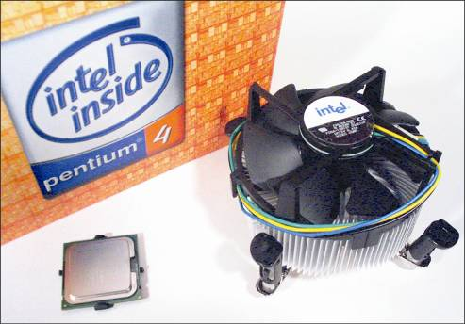
Figure 5-8 The Pentiums are sometimes sold boxed with a cooler assembly

Slide 15
The Intel Processors (continued)
Some mobile Pentium processors
  Pentium M, Mobile Pentium 4, and Celeron M
Xeon processors
  Use HT Technology and dual-core processing
  Designed for servers and high-end workstations
The Itaniums
  Utilize EPIC, a newer instruction set than CISC
  External data path is 128 bits
  L1 cache on processor die, L2 and L3 cache on board

Slide 16
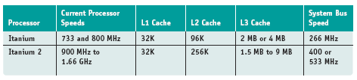
Table 5-3 The Intel Itanium processors

Slide 17
AMD Processors
Manufactured by Advanced Micro Devices, Inc
Geared to 64-bit desktop and mobile processors
Older AMD processors
  Use motherboards not compatible with Intel processors
  Earlier processors used a 321-pin socket
Current AMD processors
  For desktops: Athlon 64 X2 Dual-Core, Athlon 64 FX
  For servers: Athlon MP, Opteron
  For notebooks: Turion 64 Mobile, Mobile Athlon 64

Slide 18
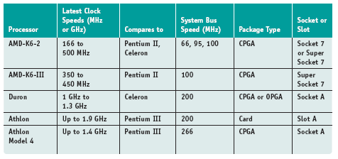
Table 5-4 Older AMD processors

Slide 19
VIA and Cyrix Processors
Use same sockets as earlier Pentium processors
Target: personal electronics and embedded devices
Three processors:
  VIA C3: comes in EBGA and nanoBGA packages
  VIA C7: for electronic devices, home theater, desktops
  VIA C7-M: designed for ultrasmall notebooks

Slide 20
Processor Packages
Processor package: provides processor housing
Flat and thin processor packages
  Lay flat in a socket or motherboard
  Connectors can be pins or lands (newer)
  Intel example: PPGA (Plastic Pin Grid Array)
  AMD example: CPGA (Ceramic Pin Grid Array)
Cartridge processor packages
  Can be installed on a slot or lay flat in a socket
  Intel example: SECC (Single Edge Contact Cartridge)
    Stands in slot 1 on the motherboard

Slide 21
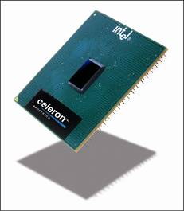
Figure 5-12 This Intel Celeron processor is housed in the PPGA form factor, which has pins on the underside that insert into Socket 370

Slide 22
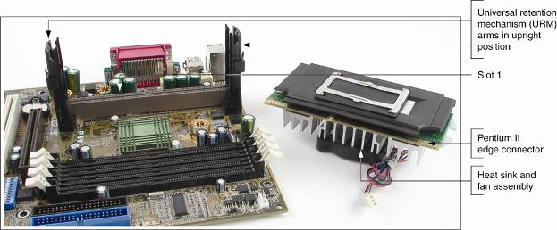
Figure 5-13 Pentium II with heat sink and fan attached goes in slot 1 on this motherboard

Slide 23
Processor Sockets and Slots
Used to connect the processor to the motherboard
Motherboard type must match processor package
Types of sockets
  Sockets are built around pin grid or land grid arrays
  Variations: PGA, SPGA, LGA, DIP, LIF, and ZIF
Types of slots
  Packages fit into slots like expansion cards
  Designated slots: Slot 1, Slot A, and Slot 2
  New processor packages use sockets, not slots
  Slocket: adapts Slot 1 to processor requiring a socket

Slide 24
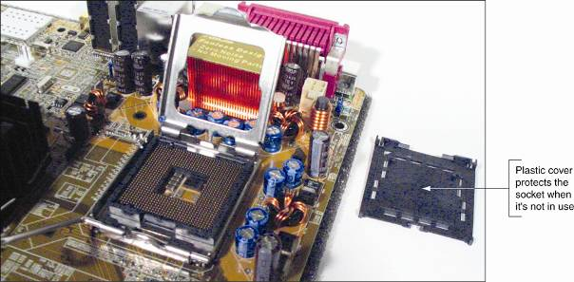
Figure 5-16 Socket LGA775 is the latest Intel socket

Slide 25
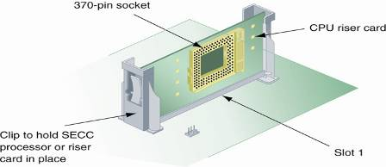
Figure 5-17 A riser card can be used to install a Celeron processor into a motherboard with slot 1

Slide 26
The Chipset
Set of chips on the motherboard
Controls memory cache, external buses, peripherals
Intel dominates the market for chipsets
  Example: i800 series of chipsets
Intel 800 series Accelerated Hub Architecture
  All I/O buses connect to a hub interface
  The hub connects to the system bus
  North Bridge: contains graphics and memory controller
  South Bridge: contains I/O controller hub
  Each bridge is controlled by a separate chipset

Slide 27
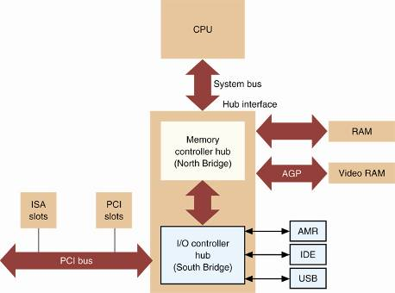
Figure 5-18 Using Intel 800 series Accelerated Hub Architecture, a hub interface is used to connect slower I/O buses to the system bus

Slide 28
Heat Sinks and Cooling Fans
Cooling assembly should keep temperatures <185° F
Target temperature range: 90° - 100° F
  One or more fans are needed to meet cooling needs
Cooling fan sits on top of processor with wire or clip
Heat sink: clip-on device pulling heat from processor
Cooler: combination of heat sink and cooling fan

Slide 29
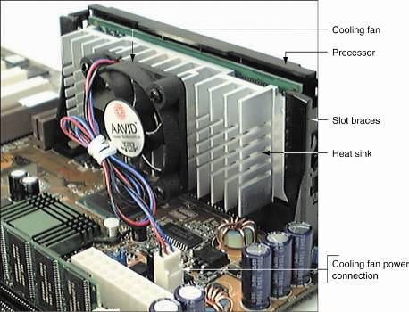
Figure 5-19 A processor cooling fan mounts on the top or side of the processor housing and is powered by an electrical connection to the motherboard

Slide 30
Installing a Processor
Types of installation technicians are asked to perform:
  Assemble a PC from parts
  Exchange a processor that is faulty
  Add a second processor to a dual-processor system
  Upgrade an existing processor to improve performance
Motherboard documentation lists suitable processors
Some processor features to consider:
  The core frequency and supported bus speeds
  Multiprocessing capabilities
  An appropriate cooler

Slide 31
Voltage to the Processor
Earlier processors drew power from system bus lines
  Newer motherboards may have a power connector
Modern motherboards regulate voltage to socket
Sockets were more universal for older processors
  Processor may fit socket, but not get correct voltage
  Ensure that motherboard supports older processor
Dual-voltage processor
  Voltages for internal and external operations differ
Single-voltage processor: requires only one voltage

Slide 32
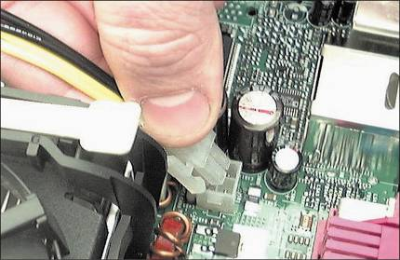
Figure 5-23 Auxiliary 4-pin power cord from the power supply connects to the ATX12V connector on the motherboard to provide power to the Pentium 4

Slide 33
CPU Voltage Regulator
Voltages could be set on some older motherboards
  Enabled motherboard to support various CPUs
Ways to configure voltage on older motherboards
  Set jumpers to configure voltage to processor
  Use a voltage regulator module (VRM)
A VRM can be embedded or installed with upgrade

Slide 34
Installing a Pentium II in Slot 1
Before beginning tasks, follow safety procedures
Summary of seven installation steps:
  1. Unfold the universal retention mechanism (URM)
  2. Determine how the cooling assembly lines up
  3. Fit the heat sink on the side of the SECC
  4. Secure the cooling assembly to the SECC
  5. Insert the cooler and SECC into supporting arms
  6. Lock the SECC into position
  7. Connect power cord from fan to power connection

Slide 35
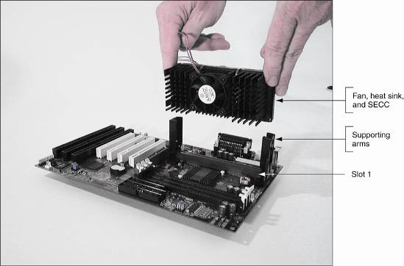
Figure 5-27 Insert the heat sink, fan, and SECC into the supporting arms and slot 1

Slide 36
Installing a Pentium 4 in Socket 478
If necessary, install frame holding the cooler in place
Summary of six installation steps:
  1. Lift the ZIF socket lever
  2. Install the processor in the socket, lower the lever
  3. Place some thermal compound on processor
  4. Attach cooling assembly to retention mechanism
  5. Push down clip levers on top of the processor fan
  6. Connect power cord from fan to power connection

Slide 37
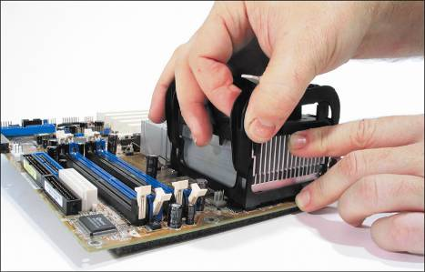
Figure 5-30 Carefully push the cooler assembly clips into the retention mechanism on the motherboard until they snap into position

Slide 38
Installing a Pentium 4 in Socket 775
Socket 775 has a lever and socket cover
Cooler is installed between Steps 4 and 5 below
Summary of five installation steps
  1. Release the lever from the socket
  2. Lift the socket cover
  3. Place the processor in the socket
  4. Close the socket cover
  5. Connect power cord from fan to power connection
After components are installed, verify system works

Slide 39
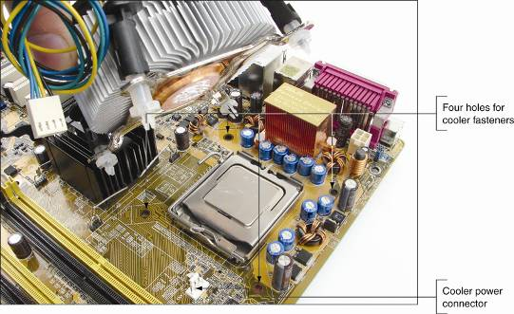
Figure 5-38 The cooler is installed on the motherboard using four holes in the motherboard

Slide 40
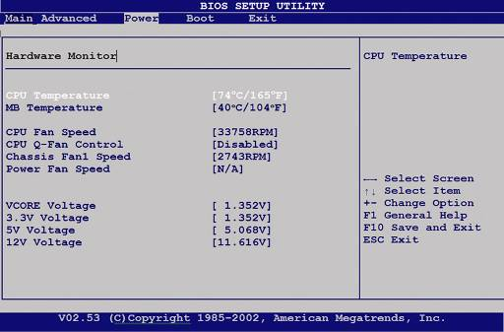
Figure 5-42 The CPU and motherboard temperature is monitored by CMOS setup

Slide 41
Summary
Basic CPU components: I/O unit, control unit, ALUs
Registers: high speed memory used by ALU in current processing
Internal cache: holds frequently used instructions
Types of buses in CPU: internal and external (system)
Standard Intel Pentium features: two ALUs, 64-bit external path size and two 32-bit internal paths

Slide 42
Summary (continued)
Processors are housed inside a processor package
Processors fit into slots or sockets in the motherboard
The chipset controls memory cache, external buses and some peripherals
A cooler comprises a cooling fan and a heat sink
A voltage regulator module (VRM) controls the amount of voltage to a processor

